Slide 1
Lecture 23
Simple Linear Regression

Slide 2
Armand’s Pizza Parlors
Armand’s Pizza Parlors is a chain of Italian-food restaurants. Armand’s most successful locations are near college campuses. The managers believe that quarterly sales for these restaurants (denoted by y) are related positively to the size of the student population (denoted by x).
Using regression analysis, we can develop an equation showing how the dependent variable (因变量) y is related to the independent variable (自变量) x.

Slide 3
Sample Data
Restaurant No. | Student Population (1000s) | Quarterly Sales (1000 Yuan)
1 | 2 | 58
2 | 6 | 105
3 | 8 | 88
4 | 8 | 118
5 | 12 | 117
6 | 16 | 137
7 | 20 | 157
8 | 20 | 169
9 | 22 | 149
10 | 26 | 202

Slide 4
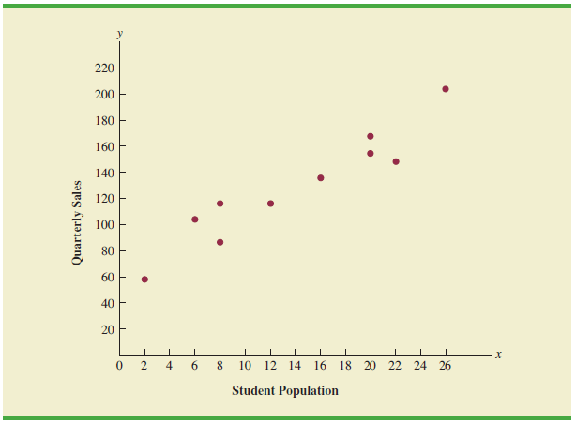
Scatter Diagram
The sample correlation coefficient between student population and quarterly sales is 0.95.

Slide 5
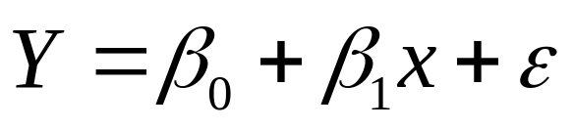
Simple Linear Regression (简单线性回归)
Dependent
Variable
Independent
Variable
Error Term
(误差项)
Parameter:
Intercept (截距)
Parameter:
Slope (斜率)
Regression Coefficients
(回归系数)

Slide 6
What does the error term mean?
The error term accounts for
the variability in y that cannot
be explained by the linear
relationship between x and y.

Slide 7
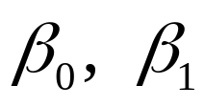
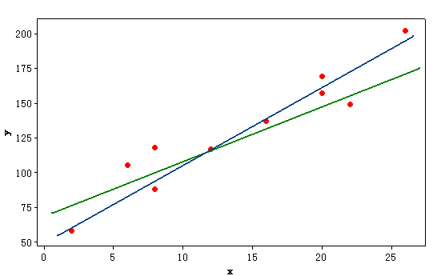
How do we estimate the parameters ?

Slide 8
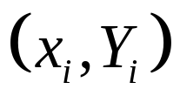
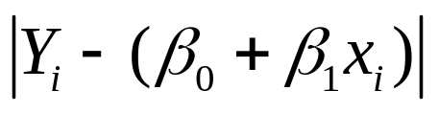
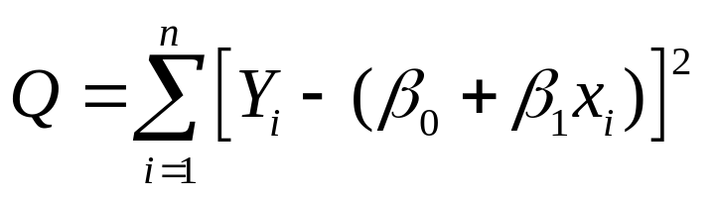
The Least Squares Line
Consider an arbitrary straight line y=β0+β1x. The vertical distance between the point and the line is . Let Q denote the sum of the squares of the vertical distances at the n points.
The method of least squares specifies that the values of β0 and β1 must be chosen to minimize Q.

Slide 9
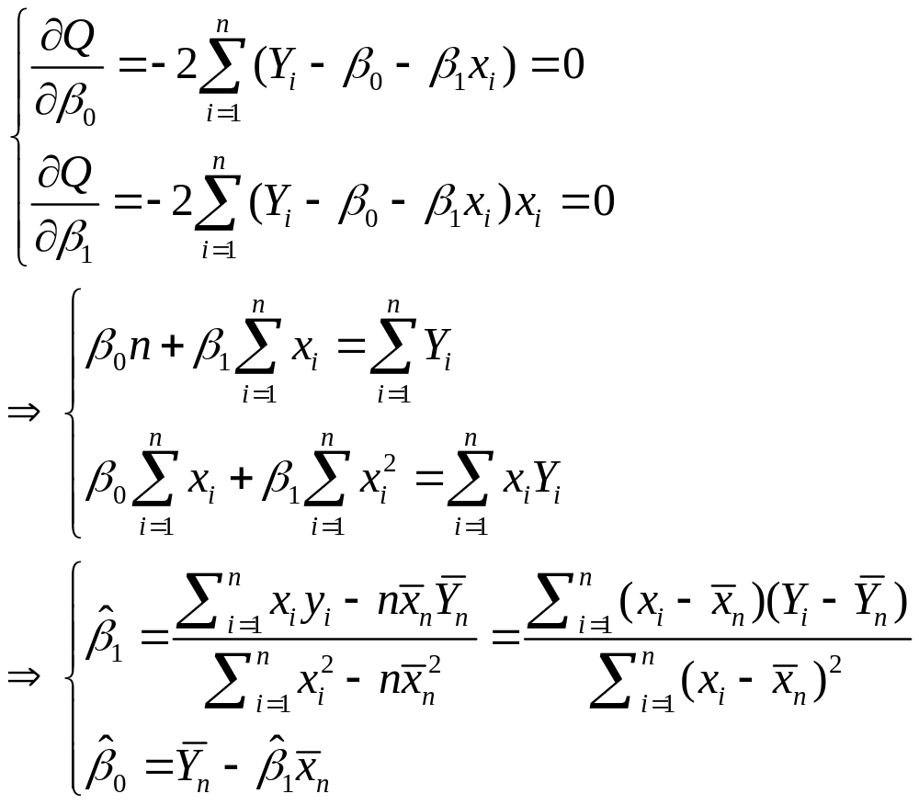
normal equations

Slide 10
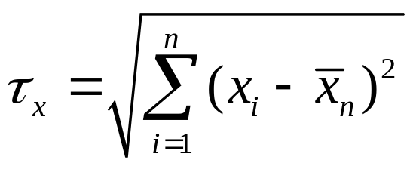
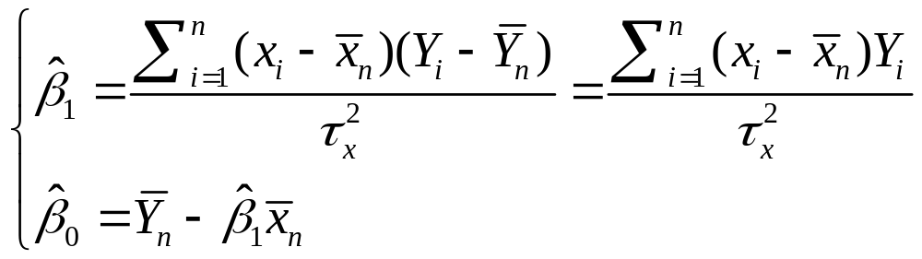
The Least Squares Estimators
Define .
The least squares estimators are:

Slide 11
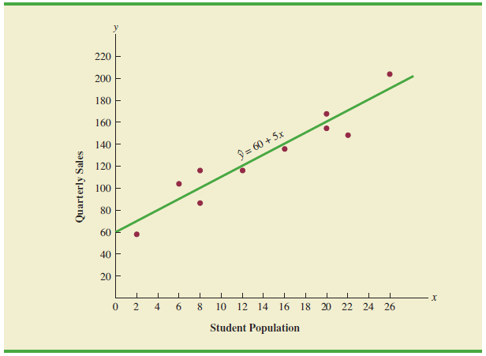
The Least Squares Line

Slide 12


Simple Linear Regression Assumptions
Assume that for any given value X=x, the random variable Y can be represented by
Y=β0+β1x+ε
where .
Therefore

Slide 13

n pairs of observations (x1,Y1),…,(xn,Yn):
  We condition on the values x1,…,xn before computing the joint distribution of (Y1,…,Yn).
  The random variables Y1,…,Yn are independent.
  For i=1,…,n,

Slide 14

Simple Linear Regression Assumptions
Linearity: E(Y|x)=β0+β1x.
Normality: each variable Yi has a normal distribution.
Independence: the variables Y1,…,Yn are independent.
Homoscedasticity: the variables Y1,…,Yn have the same variance .

Slide 15
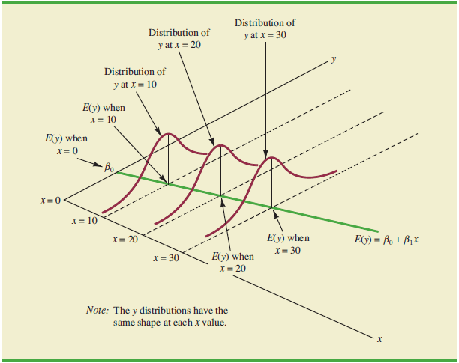
Simple Linear Regression Assumptions

Slide 16
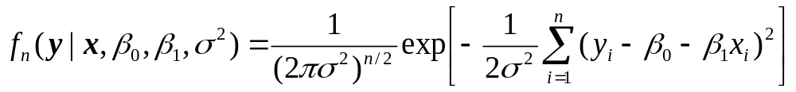
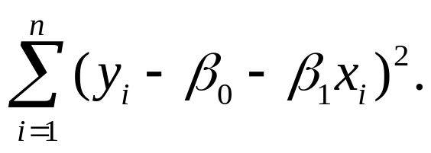
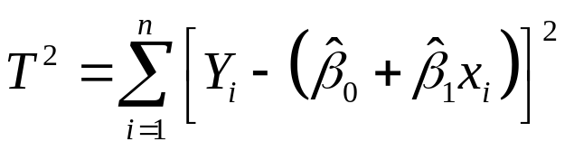
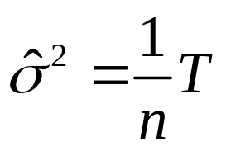
The M.L.E.
The likelihood function of β0, β1 and :
The values of β0 and β1 for which the likelihood function is a maximum will be the values that minimize
So the M.L.E. of β0 and β1 are the least square estimators.
Define . The M.L.E. for is

Slide 17


The Distribution of the Least Squares Estimators
Note that both and are linear functions of Y1,…,Yn, and they thus follow a bivariate normal distribution.

Slide 18
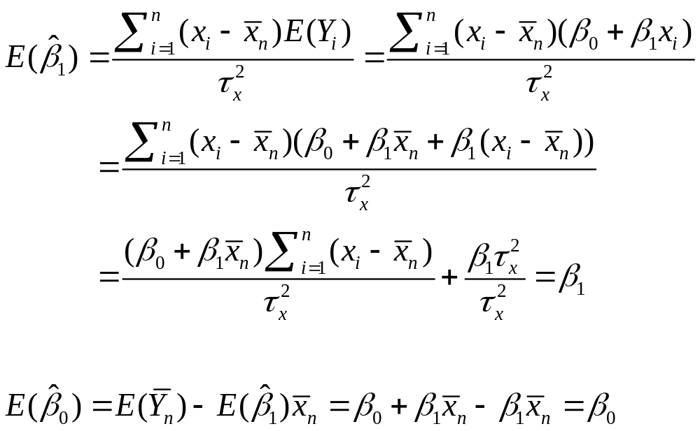

Slide 19
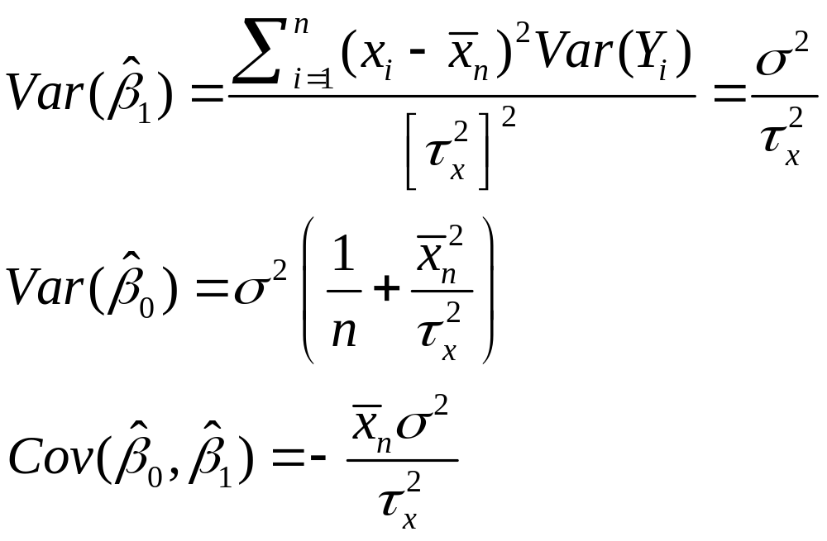

Slide 20
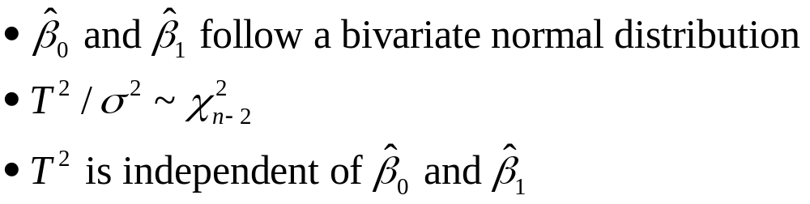
Joint Distributions of the Estimators

Slide 21
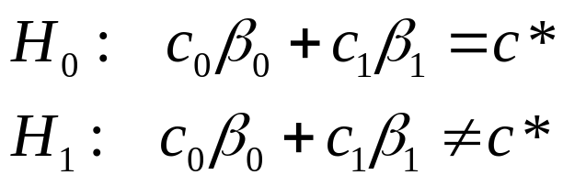
Tests of Hypotheses about the Regression Coefficients
Let c0, c1 and c* be specified numbers, where at least one of c0 and c1 is nonzero, and suppose that we are interested in testing the hypotheses:

Slide 22
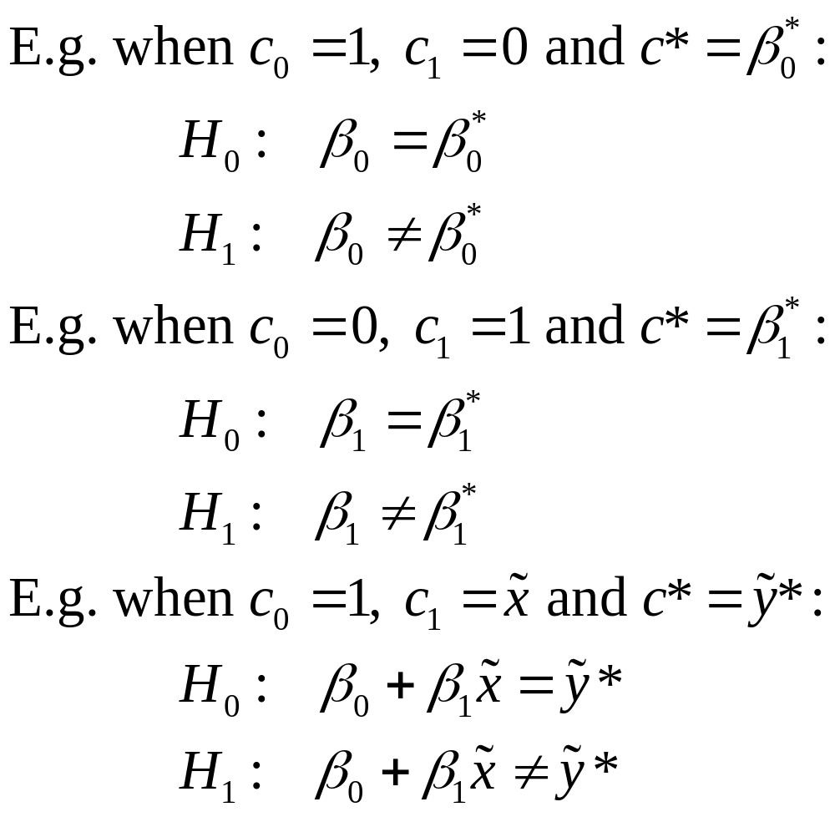

Slide 23
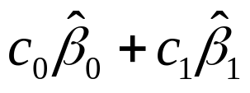
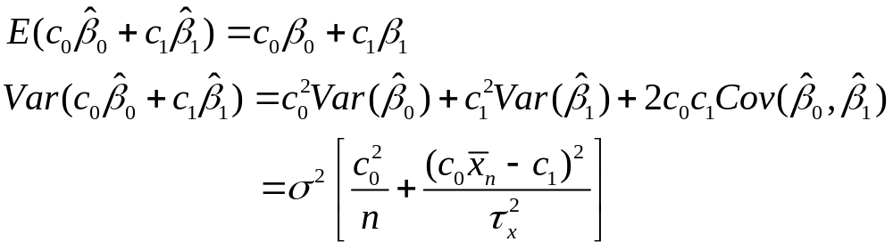
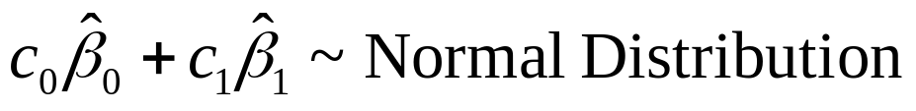
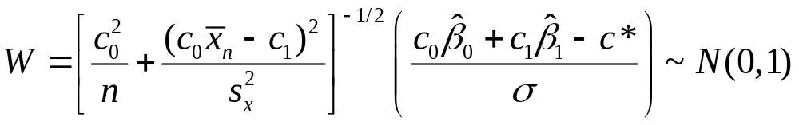
Intuition: use
Under H0,

Slide 24

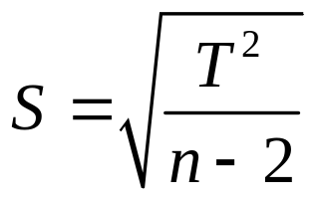


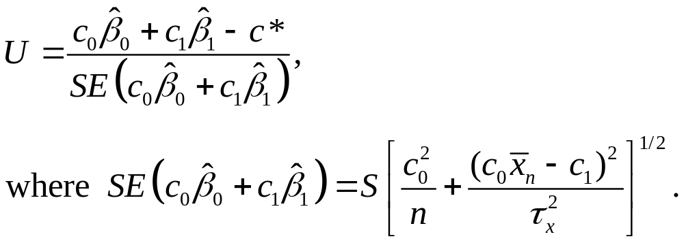
is unknown, so we need to estimate it with
is unbiased estimator of
Define

Slide 25
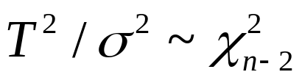


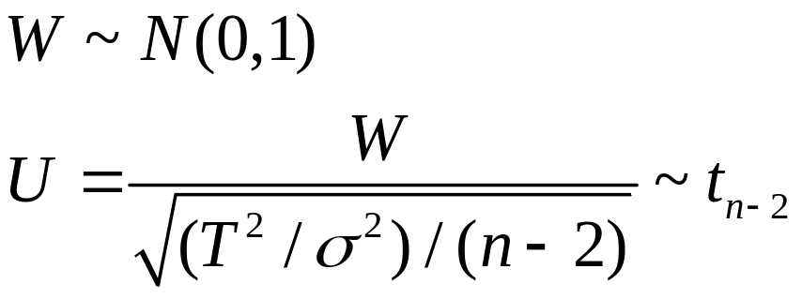
Deriving Distribution of U
Joint distribution of the estimators:
and is independent of and .
So is independent of .
Under H0,

Slide 26
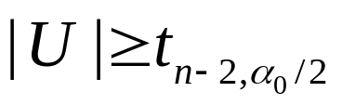
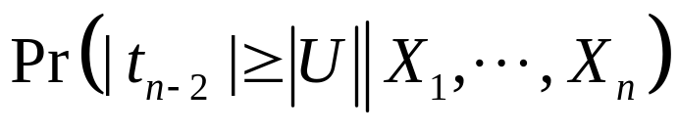
Rejection Region and p-value
So the rejection region for a level α0 test is
p-value:

